Slide 1
Understanding Conformance Testing
Using the NIST Vital Records Validation Tool
Conformance Criterion:
Transmit vital records death reports
Sandra Martinez, NIST (sandra.martinez@nist.gov )
January 9, 2017

Slide 2
Purpose
Provide an additional resource to explain the process of HIT Module conformance testing related to vital records death report messaging
Describe NIST approach for assessing and validating the test messages
Provide an overview of the testing requirements

Slide 3
Table of Contents
List of Resources
Scope of Conformance Testing
Transmit vital records death reporting conformance criterion and standard
Testing Process Diagram
Testing Workflow Diagrams
Explanation of Test Groups and Test Cases/Steps
Example Test Step Documents
Explanation of Test Data Categorization/Validation
Test Tool Overview and Example Test Tool Screen
Additional Resources

Slide 4
Resources
  Test Tool Web Site (http://hl7v2-vr-r2-testing.nist.gov/vr )
  Validation Tools
  User Documentation
    Normative Test Process Document (on Test Tool Documentation Tab)
    HL7 Version 2.6 Implementation Guide: Vital Records Death Reporting, Release 1 - US Realm Standard for Trial Use, August 2016
  (http://www.hl7.org/implement/standards/product_brief.cfm?product_id=209)
    Vital Records Tool Tutorial (on Test Tool Documentation Tab)
    Vital Records Tool Quick Reference Guide (In Process)
  Release Notes for each version of Test Tool
  (on Test Tool Documentation Tab)
      Vital Records Test Tool Google Group for submitting questions to the Test Tool developers
(https://groups.google.com/forum/#!forum/hl7v2-vitalrecords-testing)

Slide 5
Scope of Conformance Testing – Vital Records
Testing is directed at a Health IT Module (product), not specific instances (installations) of the Module
  The conformance criterion is focused on testing the capability of an HIT Module (e.g., EHR-S) to create HL7 messages for electronic transmission of vital records (VR) death reporting
  Site-specific configuration of the HIT Module is not being tested
  Method of transmitting the death reporting messages is not being tested
Testing focus and scope are narrow
  Testing encompasses only specific use cases described in the Vital Records Death Reporting Implementation Guide (IG)
  Testing does not attempt to address the entire spectrum of use cases found in practice
  How the VR messages are transmitted/exported from the HIT Module is out of scope
  Receiving of VR messages is not being tested using the VR Test Tool
HIT Module conformance testing is driven by the test data
  The HIT Module is required to demonstrate the ability to create HL7 v2 VR death reporting messages for electronic transmission; specific test data for the messages are provided in Test Cases
  The test data and Test Cases do not cover all possible VR death reporting messages; through consultation with VR death reporting experts, a subset of key reporting scenarios were selected for testing
Vital records death reporting subject matter experts, in collaboration with the National Institute of Standards and Technology (NIST), provided the Test Scenarios, Test Cases, and Test Data for the vital records (VR) death reporting conformance testing

Slide 6
Conformance Criterion – Vital Records
Transmit vital records death reports testing evaluates the capability for an HIT Module to create vital records death reporting messages according to the HL7 Version 2.6 Implementation Guide: Vital Records Death Reporting, Release 1 - US Realm, Standard for Trial Use, August 2016 interoperability standard

Slide 7
Conformance Standard – Vital Records
Electronic transmission of vital records death reports
  HL7 Version 2.6 Implementation Guide: Vital Records Death Reporting, Release 1 - US Realm, Standard for Trial Use, August 2016

Slide 8
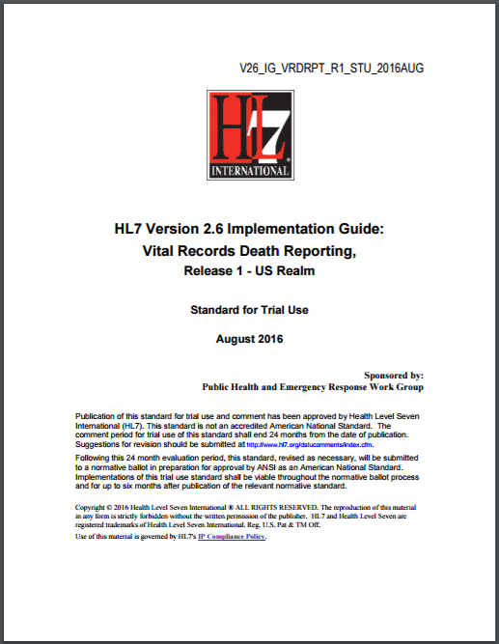
Conformance Standards Document – Vital Records
HL7 Version 2.6 Implementation Guide: Vital Records Death Reporting, Release 1 - US Realm Standard for Trial Use, August 2016
http://www.hl7.org/implement/standards/product_brief.cfm?product_id=209

Slide 9
Vital Records Death Reporting Testing Process
HL7 VR IG 2016
Vital Records Death Reporting Source
HIT Module (System under Test)
Message Imported
NIST Validation Tool (acting as Jurisdictional EDRS¹
or as NCHS²)
ADT* Message
ADT* Message
ADT* Elements
Conformance Testing Scope
Direct Data Entry
ADT* Message Elements
*A04, A08, and A11 Message Types
The HIT Module is the system being tested. The HIT Module is required to create messages that conform to the referenced standard (see previous slides).
Test data can be entered into HIT Module directly via the Module’s user interface, or can be loaded via an incoming message or using some other automated method.
The HIT Module is expected to process the test data to create a message. This message is captured and uploaded into the testing tool for validation.
Test data are available through the Test Tool via the Test Steps in the Test Scenarios. Each Test Step includes a Test Story that provides the context, a Message Content Data Sheet that shows a conformant message (in a table format), and an Example Message.
¹Electronic Death Registration System
²National Center for Health Statistics

Slide 10
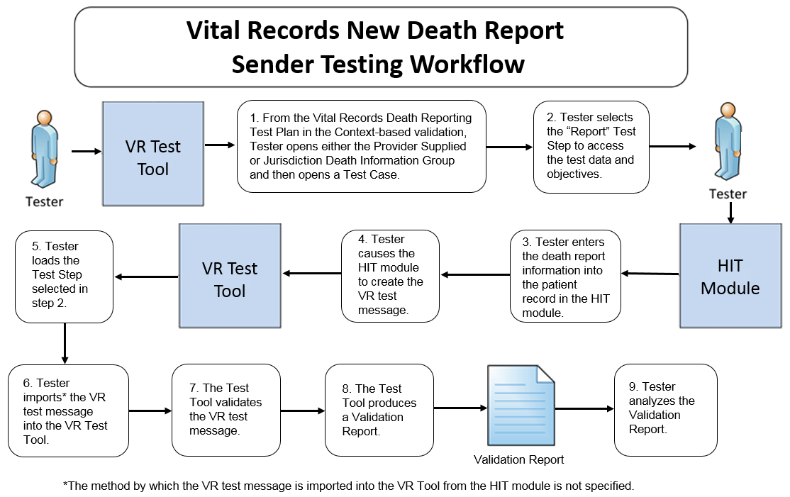
Transmit Vital Records Testing Workflow Diagram
This diagram shows
  How the steps of the transmit new vital records death report test are sequenced
  When the Test Tool is to be used

Slide 11
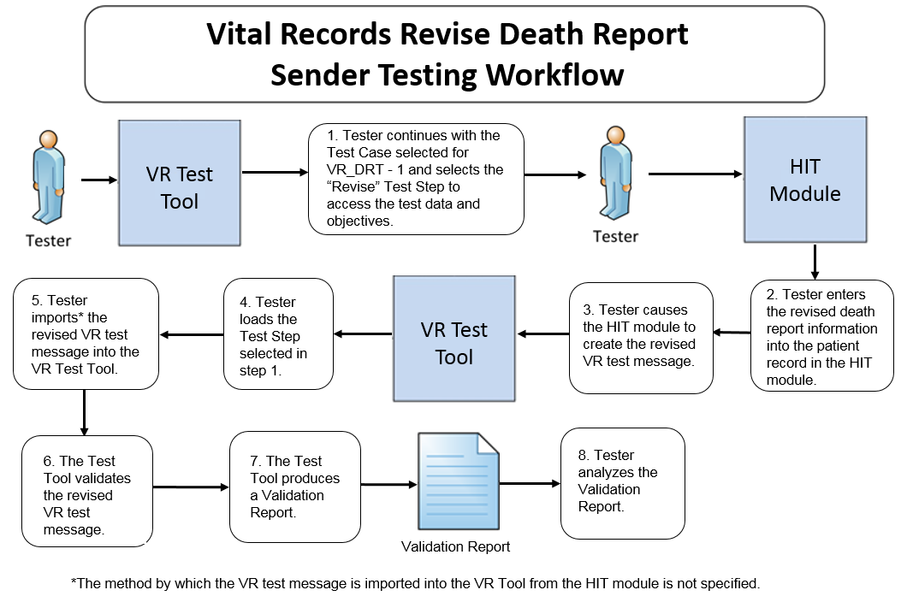
Transmit Vital Records Testing Workflow Diagram
This diagram shows
  How the steps of the transmit revised vital records death report test are sequenced
  When the Test Tool is to be used

Slide 12
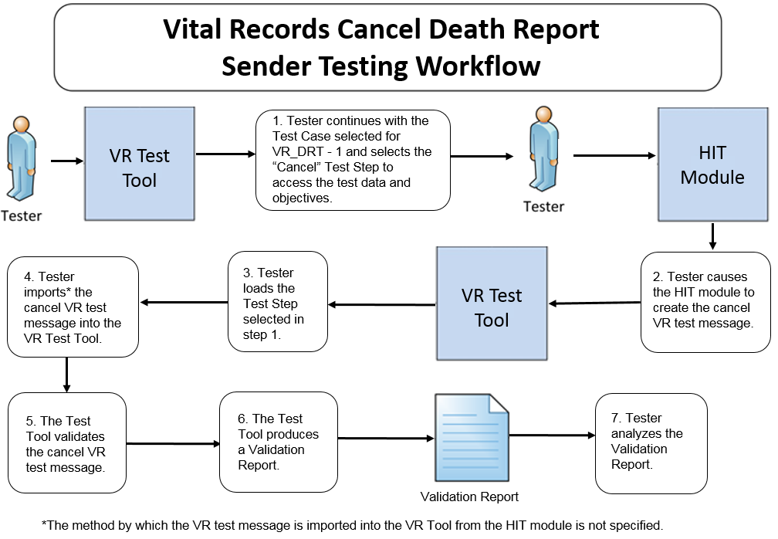
Transmit Vital Records Testing Workflow Diagram
This diagram shows
  How the steps of the transmit cancelled vital records death report test are sequenced
  When the Test Tool is to be used

Slide 13
Test Groups and Test Cases/Steps
Test data are available in the Vital Records Test Tool via two Groups of Test Cases provided in the test plan
  Provider Supplied Death Information Group (used for testing PSDI Profiles)
  Jurisdictional Death Information Group (used for testing JDI Profiles)
Each of the two Groups includes three Test Cases (or scenarios)
  Death at Home
  Death caused by Transportation Injury at work
  Death of a Pregnant Woman
HL7 Version 2.6 Implementation Guide: Vital Records Death Reporting, Release 1 - US Realm Standard for Trial Use, August 2016 interoperability standard defines three ADT Message Types relevant for conformance testing:
  ADT^A04 Register a Patient
  ADT^A08 Update Patient Information
  ADT^A11 Cancel Patient Information
The three Test Cases in each of the Groups are composed of three Test Steps corresponding to the three ADT Message Types defined in the IG
Each Test Step includes a Test Story, Message Content Data Sheet, and Example Test Message

Slide 14
Test Groups and Test Cases/Steps (cont’d)
HL7 Version 2.6 Implementation Guide: Vital Records Death Reporting, Release 1 - US Realm Standard for Trial Use, August 2016 interoperability standard defines six Base Profile IDs relevant for conformance testing:
  PSDIA04_V1.0 Report Provider Supplied Death Information
  PSDIA08_V1.0 Revise Provider Supplied Death Information
  PSDIA11_V1.0 Cancel Provider Supplied Death Information
  JDIA04_V1.0 Report Jurisdiction Death Information
  JDIA08_V1.0 Revise Jurisdiction Death Information
  JDIA11_V1.0 Cancel Jurisdiction Death Information
The two Groups of Test Cases in the Tool include
  Three Test Cases for the PSDI Profiles
  Three Test Cases for the JDI Profiles
For the purpose of conformance testing, when the system under test (SUT)
  Is used by healthcare providers for death reporting, all three Test Steps from the three Test Cases in the Provider Supplied Death Information Group apply
  Is used by jurisdictions for death reporting, all three Test Steps from the three Test Cases in the Jurisdictional Death Information Group apply

Slide 15
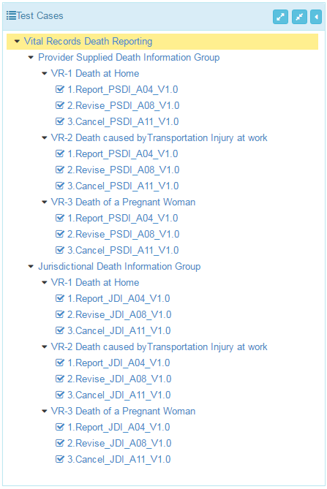
Test Groups and Test Cases/Steps (cont’d)
Test Groups/Cases/Steps for the six Base Profile IDs and three ADT Messages are provided in the VR test plan in the VR Tool
This figure shows how the two Test Groups and their Test Cases/Steps appear in the Tool
The Tester shall execute all three Test Cases in the Provider Supplied Death Information Group when the SUT is used by healthcare providers for death reporting
The Tester shall execute all three Test Cases in the Jurisdictional Death Information Group when the SUT is used by jurisdictions for death reporting
Test Group
Test Case
Test Step
Test Group
Test Case
Test Step

Slide 16
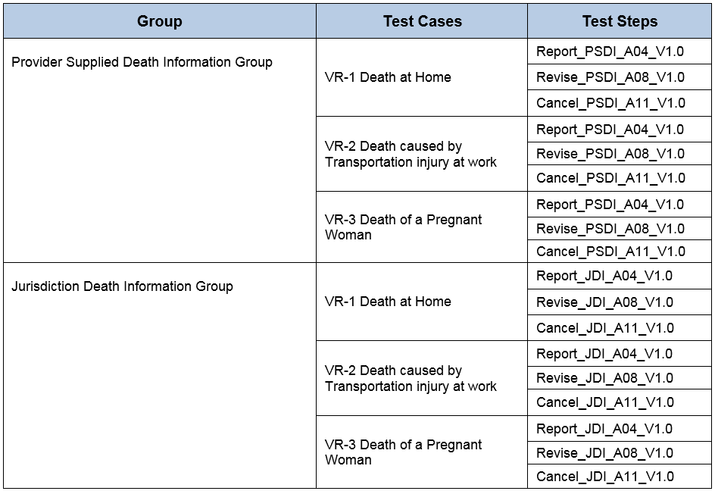
Test Groups and Test Cases/Steps (cont’d)
Test Cases/Steps for the two Test Groups are shown in the table below

Slide 17
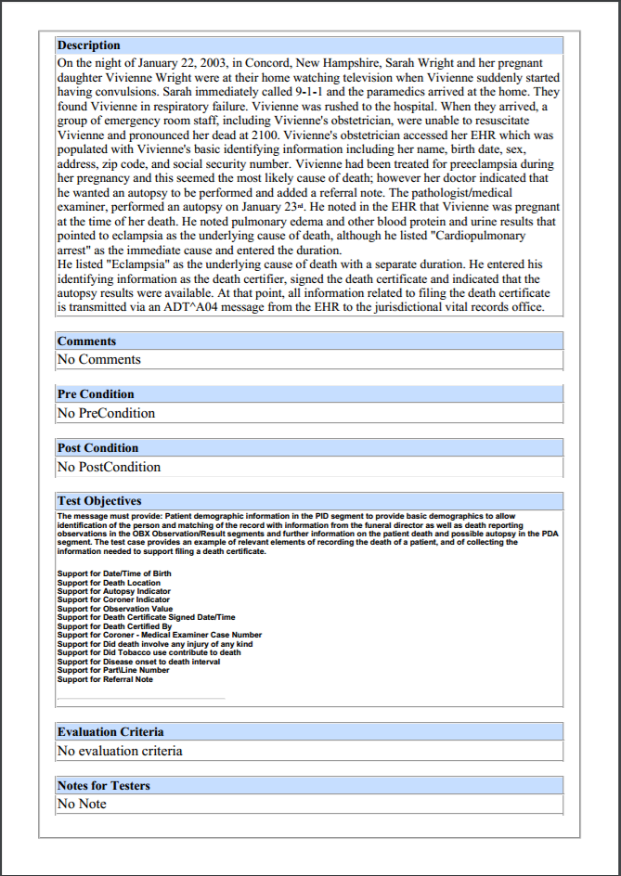
Test Data Documents* for Each Test Step
Test Story
Each Test Step includes a narrative Test Story that describes a real world situation and provides context for the Test Step
Along with the Test Story description is information about PreConditions, PostConditions, Test Objectives, and Notes for Testers
Example: Test Data pdf document for the VR-3 Death of a Pregnant Woman / Report_PSDI_A04_V1.0 Test Step
*Available for viewing online and via downloaded pdf or txt file

Slide 18
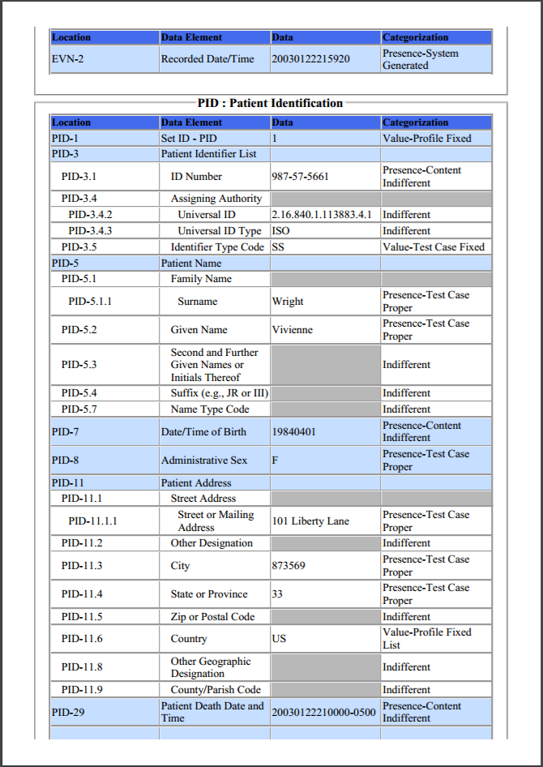
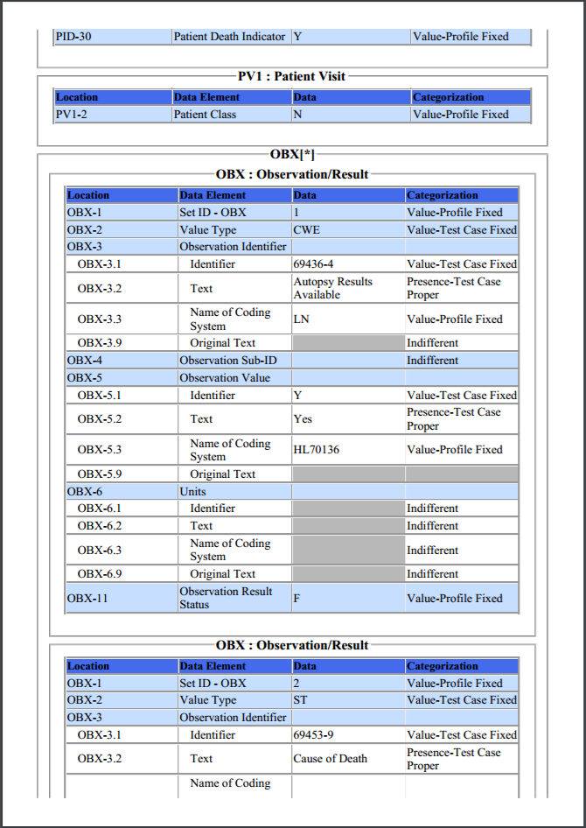
Test Data Documents for Each Test Step (cont’d)
Message Content Data Sheet
Each Test Step includes a Message Content Data Sheet that shows a conformant message instance
The category of the test data is listed in the Categorization column
The Categorization indicates how the data in the messages that are imported into the Tool are assessed by the validation engine
  (See Test Data Categorization and Validation slides for more details)
Example: Test Data pdf document for the VR-3 Death of a Pregnant Woman / Report_PSDI_A04_V1.0 Test Step
18
Notes:
18

Slide 19
Test Data Documents for Each Test Step (cont’d)
Example Test Message
MSH|^~\&|89898989|Best Care LLC|StateAppID|VRDept|20030122191200-0400||ADT^A04^ADT_A01|1223334499|P|2.6|||NE|NE|US||||PSDIA04_V1.0^PHIN VS
EVN||20030122215920|
PID|1||987-57-5661^^^&2.16.840.1.113883.4.1&ISO^SS||Wright^Vivienne||19840401|F|||101 Liberty Lane^^873569^33^^US||||||||||||||||||20030122210000-0500|Y
PV1||N
OBX|1|CWE|69436-4^Autopsy Results Available^LN||Y^Yes^HL70136||||||F
OBX|2|ST|69453-9^Cause of Death^LN|1|Cardiopulmonary arrest||||||F
OBX|3|ST|69440-6^Disease Onset to Death Interval^LN|1|4 hours||||||F
OBX|4|NM|PHC1428^Part\Line Number^CDCPHINVS|1|1||||||F
OBX|5|ST|69453-9^Cause of Death^LN|2|Eclampsia||||||F
OBX|6|ST|69440-6^Disease Onset to Death Interval^LN|2|3 months||||||F
OBX|7|NM|PHC1428^Part\Line Number^CDCPHINVS|2|2||||||F
OBX|8|ST|69452-1^Coroner - Medical Examiner Case Number^LN|2|2344509||||||F
OBX|9|DTM|31211-6^Date of Death^LN|2|200301222100-0500||||||F
OBX|10|CWE|69437-2^Certifier Type^LN||440051000124108^Medical Examiner^SCT||||||F
OBX|11|CWE|71481-6^Did the death of this person involve injury of any kind^LN||N^No^HL70136||||||F
OBX|12|CWE|69449-7^Manner of Death^LN||38605008^Natural Death^SCT||||||F
OBX|13|DTM|80616-6^Date/time pronouced dead^LN||200301222100-0400||||||F
OBX|14|ST|69438-0^Referral Note^LN|2|Autopsy requested by pronouncing doctor ||||||F
OBX|15|XAD|69435-6^Street address where death occurred if not facility^LN||101 Liberty Lane^^873569^NH^^US||||||F
OBX|16|CWE|69442-2^Timing of Recent Pregnancy Related to Death^LN||PHC1261^Pregnant at the time of death^CDCPHINVS||||||F
OBX|17|NM|39016-1^Age at death^LN||18|a^year^UCUM|||||X
PDA||^^^^^16983000^^^Concord Regional Hospital||200301231200|12124343^Freeman^Robert^^^^^^&2.16.840.1.113883.4.1&ISO^^^^NPI^|Y||12124343^Freeman^Robert^^^DR^^^&2.16.840.1.113883.4.1&ISO^^^^NPI^&2.16.840.1.113883.4.1&ISO|Y
A test message is provided that coincides with the Test Story for the Test Step
For the VR test plan, the VR test messages are exported (sent) by the HIT Module being tested and are imported (received) by the VR Test Tool (acting either as the Jurisdictional Electronic Death Registration System (EDRS) or as the National Center for Health Statistics (NCHS)
Example: Test Message for the VR-3 Death of a Pregnant Woman / Report_PSDI_A04_V1.0 Test Step

Slide 20
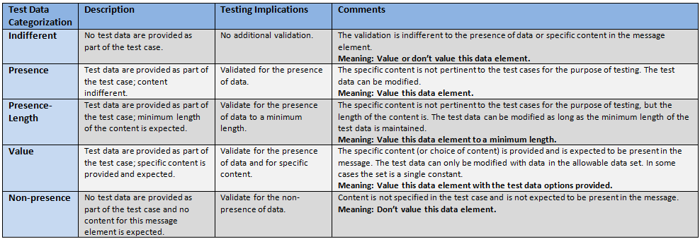
Test Data Categorization and Validation
The Message Content Data Sheet shows the Categorization of the test data that are provided for each Location
Each Test Data Category
  Defines the criteria that are used by the test tool to assess the test data that populate each field in a message
  Tells the Tester if the test data in a specific field can be changed, the source of the test data, and to what level of precision the validation tool will assess the data

Slide 21
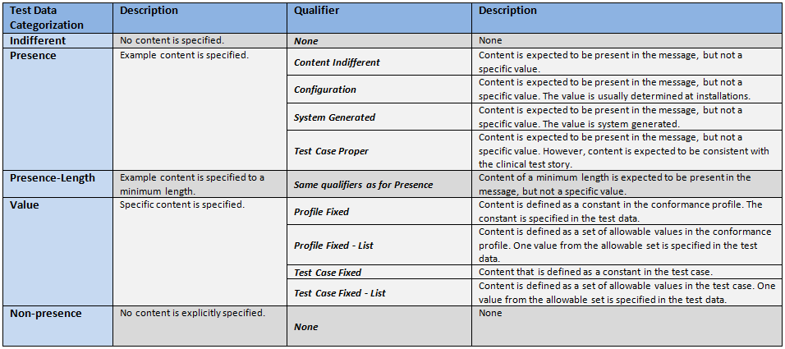
Test Data Categorization and Validation (cont’d)
Qualifiers enable refinement of the Test Data Category, providing additional information to the Tester about the source of the data and the expectations of the data element
The Qualifier does not affect the validation of the data element

Slide 22
Test Category Assessment Table (Examples)
Element | Usage | Test Data | Test Category | Conformity Assessment | Data in Message | Validation Result
PID-5.3 (Middle Name)* | RE | Donna | Presence-Content-Indifferent | Required | <Empty> | Fail
PID-5.3 (Middle Name) | RE | Donna | Presence-Content-Indifferent | Required | Donna | Pass
PID-5.3 (Middle Name) | RE | Donna | Presence-Content-Indifferent | Required | Sue | Pass
PID-5.3 (Middle Name) | RE | Donna | Presence-Length-Content-Indifferent | Required Min Length = 5 | Victoria | Pass
PID-5.3 (Middle Name) | RE | Donna | Presence-Length-Content-Indifferent | Required Min Length = 5 | Sue | Fail
PID-5.3 (Middle Name) | RE | Donna | Value-Test Case Fixed | Required Value = Donna | Donna | Pass
PID-5.3 (Middle Name) | RE | Donna | Value-Test Case Fixed | Required Value = Donna | Sue | Fail
MSH-9.2 (Trigger Event) | R | V04 | Value-Profile Fixed | Required Value = V04 | V04 | Pass
* Actual description is “Second and Further Given Names or Initials Thereof”

Slide 23
Test Data Validation Example
Example Message Segment:
  OBX|1|CWE|69436-4^Autopsy Results Available^LN||Y^^HL70136||||||F
Location | Data | Categorization | Assessment
OBX-3.1 | 69436-4 | Value-Test Case Fixed | Content is defined as a constant in the test case, and it must be present and exactly “69436-4”
OBX-3.2 | Autopsy Results Available | Presence-Test Case Proper | Content is expected to be present in the message, but not a specific value; content is expected to be consistent with the clinical test story
OBX-3.3 | LN | Value-Profile Fixed | Content is defined as a constant in the conformance profile, and is specified in the test data; content must be present and exactly “LN”
OBX-5.1 | Y | Value-Test Case Fixed | Content is defined as a constant in the test case, and it must be present and exactly “Y”
OBX-5.2 |  | Indifferent-None | No content is specified, content is not expected, but content may be present in the message
OBX-5.3 | HL70136 | Value-Profile Fixed | Content is expected to be present in the message, but not a specific value; content is expected to be consistent with the clinical test story

Slide 24
Test Data Validation – Sequencing of Segments
The NIST context-based testing performs specific content validation depending on the Category/Qualifier combination assigned to the Data Elements in the message.
In some cases, in order to perform this type of validation the NIST Tool expects the segments/segment groups in the message to be sequenced in a certain order. The complexity of automatically evaluating specific content necessitates this approach.
If the Message Validation Result generated by the NIST Tool indicates content-related errors, the Tester may change the order of the segments/segment groups in the test message to match the Test Case once the message has been loaded into the Message Content window of the Test Tool.
These kinds of content-related errors do not imply a failure of the vendor product nor a requirement to create the message with the segments/segment groups in a certain order (beyond the base message structure).

Slide 25
NIST Vital Records Test Tool Overview
  Purpose: The tool validates vital records death reporting messages created by HIT Modules and is intended to be used for conformance testing according to the standard listed on the Conformance Standard page of this slide set
Tool Key Capabilities
Context-based testing / VR test plan | Used for conformance testing driven by test data Validates HIT Modules that create HL7 messages in accordance with the HL7 Version 2.6 Implementation Guide: Vital Records Death Reporting, Release 1 - US Realm, Standard for Trial Use, August 2016
Profile Viewer | Provides a browse-able version of the conformance profile that encapsulates the requirements. Profile Viewer tab is accessible in Context-based testing once a Test Case/ Step is “loaded”. Can be used to assist in the interpretation of message errors.
Value Sets Browser | Provides a browse-able view of the Value Sets and Vocabulary requirements. Value Sets tab is accessible in Context-based testing once a Test Case/Step is “loaded”. Can be used to assist in the interpretation of value set errors.
Documentation | Provides access to documents that assist in using the Tool for conformance testing (including the NIST Normative Test Process Documents, Implementation Guides, and Release Notes).
  No registration or log-in credentials are required. Simply click on the link below to access and use the Tool
  NOTE: The Test Tool (.war file) can also be downloaded and installed locally.
  NOTE: Web Application is compatible with Firefox, Chrome, Safari, and IE9+. Recommended browsers are Firefox and Chrome.
  Register to Google Group at: https://groups.google.com/forum/#!forum/hl7v2-vitalrecords-testing to ask questions and provide feedback.
http://hl7v2-vr-r2-testing.nist.gov/vr

Slide 26
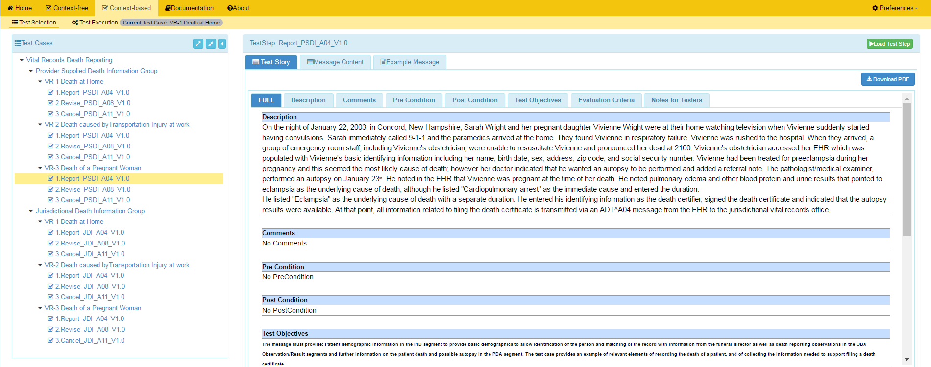
NIST Vital Records Test Tool Screen Shot
1
Open LRI Validation tool using link:
and click on Context-based
http://hl7v2-vr-r2-testing.nist.gov/vr
2
Test Selection view of page displays.
3
Click on arrow to open the VR test plan.
4
Click on arrows to expand the Test Group and Test Cases. Click on a Test Step.
5
Test Step Title and Test Story tab display.
6
Click Message Content tab to view and download the Message Content Sheet.
HIT Context-based Validation
This feature is used to test HIT Modules for conformance to the Vital Records (VR) Death Reporting standard. The validation involves automated testing that assesses the VR messages created by the Module and “sent to” the NIST Test Harness.
7
Click on Load Test Step button to proceed with conformance testing for the Test Step

Slide 27
Resources
  Test Tool Web Site http://hl7v2-vr-r2-testing.nist.gov/vr provides
  Test Tool (API, Web Application, and Desktop)
  Test Cases/Steps, Test Stories, Message Content Sheets, Example Messages
  User Documentation
  Testing Artifacts
    Message Profiles
    Value Sets
    Validation Reports
Contact
  Sandra Martinez (sandra.martinez@nist.gov )

